Slide 1
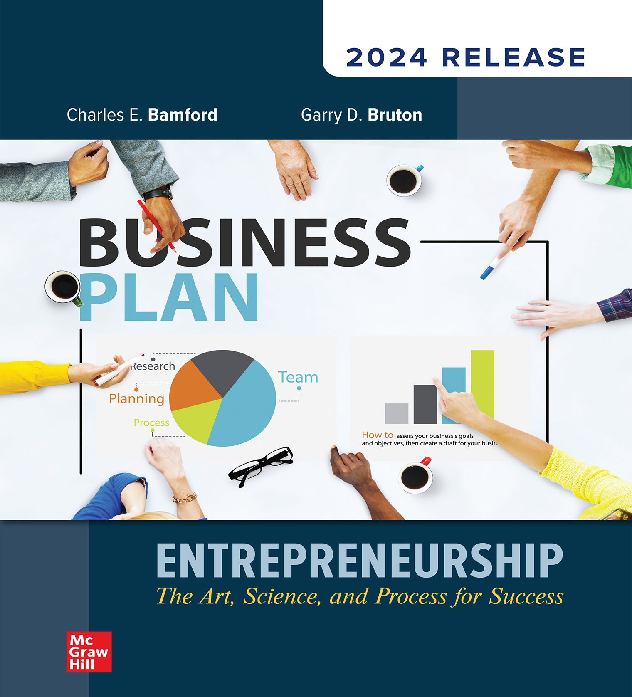
Chapter 4
External Analysis
Notes:
This is the first chapter of Part Two: Due Diligence on the Business Idea.
Chapter Four: External Analysis

Slide 2
Defining Your Industry
Entrepreneurs should be as specific as possible.
If opening an ice-cream store, entrepreneurs should ask themselves:
In what industry does a new ice-cream store compete?
Does it include dessert providers, such as bakeries?
Does it compete with grocery stores that sell packaged ice cream?
Is it high-end, high milk-fat ice cream?
Defining the industry is not to be taken lightly.
Do your research – If you think you have no competition, keep looking.
Notes:
Learning Objective 4-1: Describe how to examine the industry that the new business plans to enter.
The first part of an external analysis is to determine the industry within which the new business will compete, as well as the general makeup of the industry. In doing so the entrepreneur should seek to be as specific as possible.
For example, if you want to open a new ice-cream store, you might ask, in what industry does a new ice-cream store compete? Clearly, the industry will include other ice-cream stores.
However, if the ice-cream store will make a significant part of its revenues from selling ice-cream cakes, then the industry might be best viewed as including a broader group of dessert providers, such as bakeries and other businesses that sell competing products.
If the ice-cream store has both dipping operations where the ice cream is sold in cones and prepackaged gallons of ice cream, perhaps the industry includes competitors that sell ice cream in grocery stores.
The industry may also vary if the ice cream is high end with a high milk-fat content versus more typical ice cream that has much lower milk-fat level.
Defining the firm’s industry is not something that should be taken lightly.

Slide 3
Defining Your Industry
Entrepreneurs should:
Define their industry broadly enough to include all potential competitors, but not so broad as to be overwhelming.
Be clear about the practical level of actual competition.
What is a reasonable geographic customer draw for a new business?
Those companies within a specified geographic radius that will be in direct competition for the same customers and sales as that of the new business.
Notes:
Learning Objective 4-1: Describe how to examine the industry that the new business plans to enter.
Entrepreneurs should define the industry in which they will compete broadly enough to be inclusive of all potential competitors, but not so broadly as to be overwhelming.
Even more important, the entrepreneur must be clear about the practical level of actual competition.
An entrepreneur should ask, what is a reasonable geographic customer draw for a new business?
Opening a sandwich shop in the downtown area of a city means that the shop most likely competes with other sandwich or fast-food shops within a 10-block radius—and perhaps less, if walking is the primary means of transportation for downtown lunching workers.
Drawing a practical radius around your potential new business location will also help target the customers who are most likely to patronize your business.

Slide 4
Defining Your Customers
Entrepreneurs should:
Define a narrow group of individuals whom they believe will be their most likely customers.
Be diligent in the effort to be as accurate as possible.
Helps the new business:
Focus on its core customer.
Maintain a strategic distance from its competitors.
Control expenses.
Notes:
Learning Objective 4-2: Discuss how to create a profile of the target customers for a new business.
Once the industry is broadly defined, then the exact nature of the customer should be developed. It is important to define a narrower group of individuals whom you believe will constitute your most likely customers.
Where are they located? Where do they currently obtain their product or service?
In defining the customer, the entrepreneur should be diligent in the effort to be as accurate as possible.
We will discuss promotional activities such as advertising in Chapter 11 (“Marketing”), but here we note that defining the customer is important for the effective use of your marketing dollars, as well as the satisfaction of core, repeat customers.
This approach helps the entrepreneurial business clearly focus on its core customer.
It also helps the business maintain a strategic distance between itself and its competitors, as the firm is not trying to do what everyone else may do.
Finally, a clear understanding of the business’s customers assists the owners in controlling expenses because the business does not try to be everything to everybody. The inventory can therefore be much more focused.

Slide 5
External Analysis of Competitors
Identifying exact competitors who directly compete for the same set of ideal customers.
By researching the industry themselves, the entrepreneurs will:
Gain invaluable insight.
Make themselves an expert.
Enable themselves to plan a business with a competitive advantage.
Notes:
Learning Objective 4-3: Explain how to categorize competitors of the new business using external analysis.
At this point, you should have defined the industry that interests you, determined who your potential customers might be and why they might want to buy from your business, and gathered some information on these domains.
The next issue is to identify the exact competitors within that industry. These competitors are those firms that directly compete for the same set of ideal customers as your proposed business.
Although it is certainly possible to hire a consulting company to perform the type of customer research service discussed, the entrepreneur will gain invaluable insight by handling this process personally.
Doing so will make you an expert in the area and enable you to develop a plan for a business that will give you a competitive advantage.
The benefits of planning and analysis are the nuanced insights it provides the individuals performing the activities. Hiring a company to gather information is not only expensive but also limits the insights to more factual data.

Slide 6
4 Steps to Customer Development
Step 1 - Customer Discovery
Capture Founders Vision
Turn the Vision into a series of business model hypothesis
Develop a plan to test customer reaction to each hypothesis
Turn each successful hypothesis into FACT

Slide 7
4 Steps to Customer Development
Step 2 - Customer Validation
Test whether the resulting business model is repeatable and scalable
If not, return to Customer Discovery
Don’t throw away your document/research

Slide 8
4 Steps to Customer Development
Step 3 - Customer Creation
This is the start of execution
Builds your customer demand
Drives into sales channels
Ability to scale the business as demand increases

Slide 9
4 Steps to Customer Development
Step 4- Company Building
Transitions the organization from a startup to a company focused on continuing to execute your validated Business Model

Slide 10
Introduction to Customer Development
The 5 W’s and 1 H
Who are your customers?
What are their needs?
To overcome a problem or desire
When are they looking to buy?
Where are they located – demographic/Cloud N/A
Why are they buying
How Much and How Often are they buying: Scalable - frequent

Slide 11
Customer Discovery Process
Step 1 in the Customer Discovery Process
Identify the problem/need
The GUESS (Hypothesis)
So ask yourself – What am I selling
Go beyond the product/service to emotionally connect with your customer base
Your Vision and Passion (Nike, Apple, Amazon)
Does what I see fix the want or need of my customer base?

Slide 12
Customer Discovery Process
Step 2 in the Customer Discovery Process
Get out of the building – go investigate - research
This process can take weeks – months and be revisited
Define your clients – target market
Who are them
You may be wrong – it’s ok, better to know early
Reduce issues of spending a lot of money
Look to sell to a small group before feeling obligated to reach a mass market – lower costs

Slide 13
Customer Discovery Process
Step 3 in the Customer Discovery Process
Focus group – once you’ve defined your target
Bring in several groups
Ask lot of questions
Don’t mislead
Hold Discovery Sessions (Coffee – cheaper)
Talk to folks that can help – get feedback (Platinum P)
Find talent/partners/advocates/educators online
Facebook / Linked In / Craigslist/ Other business/ WOM
Can offer suggestions – support – devil’s advocate

Slide 14
Industry Trends
Shape the long-term prospects of the industry.
The United States is moving to a self-service economy.
Companies that can move that process forward or take advantage of this movement appear to have an opportunity for success.
Healthy, mid-price-range restaurant sales have been increasing dramatically.
Restaurant that enters an emerging market may be able to create a niche and gain a competitive advantage.
Notes:
Learning Objective 4-5: Ensure that the entrepreneur has considered a full set of concerns in their external analysis.
An overarching part of any analysis of competitors is an understanding of the trends in the industry. These trends shape the long-term prospects of the industry.
For example, the United States is moving toward a more self-service economy, and companies that can move that process forward or take advantage of this movement appear to have an opportunity for success.
Another example might be restaurant patronage. Whereas the number of people eating at restaurants has not changed dramatically over the past few years, what they eat has been changing in a consistently predictable manner.
Healthy, mid-price-range restaurant sales have been increasing dramatically.
As a result, a restaurant that enters an emerging market (e.g., utilizing the Keto Diet or another diet craze as a menu theme) may be able to be among the first to enter that niche, and thereby gain an advantage over other firms.

Slide 15
Exit Strategy
Define how you see your business existing should that opportunity arise.
Convert to franchise
Hold and create a legacy for future family
Sell to new owner/business
Merge
Plan to grow to a certain value to become a valid return on sale
Look for a big company to assume your company
Notes:
Learning Objective 4-5: Ensure that the entrepreneur has considered a full set of concerns in their external analysis.
To illustrate an exit barrier, consider the principal investments for a clothing store, which are the clothes in the store. Clothes tend to be very seasonal. If a piece of clothing is not sold in season, then it likely has limited value in the near future.
The owner will need to sharply discount the price of the goods just to get as much of their invested money back before they have to close the store.
If a business owner cannot easily exit an industry, then that owner is more likely to use predatory pricing in an effort to generate cash flow and survive.
In the golf example, the initial investment for the golf course is very high, but the ease of exiting the business is also very high, as the real estate could be converted to another use such as a housing tract; thus, in the case of the golf course, there is no real exit barrier.
The ability to exit a business relatively easily tends to limit the intensity of competition in the industry and reduce the threat posed by a new entry.

Slide 16
Competitive Advantage
A set of offerings or capabilities that have the potential to provide the business with sustained success.
Understanding the competitive advantage is the last step in external analysis.
Reason why customers go to one particular business and not to one of its competitors.
Notes:
Learning Objective 4-6: Differentiate between those elements of the business that provide a competitive advantage and those that do not.
Competitive advantage: A set of offerings or capabilities that have the potential to provide the business sustained success.
Once the industry, customer, and competitor issues have been clearly identified, an entrepreneur must develop a deep understanding of the competitive advantage they expect to hold.
A competitive advantage is made up of those things that your business does uniquely well or better than anyone else in your industry (remember the industry, and it consists of those businesses in direct competition with you in your area).
Understanding the competitive advantage is the last step in your external analysis.
While the text discusses competitive advantage in greater detail in Chapter 5, it is important at this point to understand that these advantages (hopefully there will be several) will ultimately be the reason that individuals come to your business and not to one of your competitors.

